Slide 1


Android SMS Translator
Vladimir Novikov 312669112
Eran Naor 300511987

Slide 2
Summary
SMSTranslator is an Android application that automatically recognize foreign language written in your income SMS messages and immediately connects to the internet and suggest you the best translation directly to your native language

Slide 3
Features
Translations of a variety of languages
Automatically locates your native language from the machine GPS coordinates
User defined words
Vibrate, Flash and modified rings alerts
Remembers contacts language

Slide 4
Requirements
A second line of text can go here.
Here is the description of the table. You may change or delete this text as you wish.
This chart is compatible with PowerPoint 97 to 2007.
Here is a placeholder for more text and description of the chart. Changing this text will not interfere with the formatting of this template.
# | Requirement | Description
1 | Android Version | 4 >
2 | GPS | Suggest locale language for the user
3 | Internet Connection | The translation works online
4 | SMS | The application translate only incoming\outgoing SMS’s

Slide 5
Architecture
http://stackoverflow.com/questions/17056168/google-translate-or-similar-api-for-android
https://developers.google.com/translate/v2/getting_started?csw=1

Slide 6
Usage
SmsManager
HTTP calls
Rest api
Provider
Services
GPS
Sqlite
Asynchronies tasks

Slide 7
Tests

Slide 8
Working example???
Main application feature should be represented here + pictures

Slide 9
Farther development
Pull data text from multiple translate services and get the best result
Remember user defined words
Send SMS thorugh wifi
Camera OCR

Slide 10
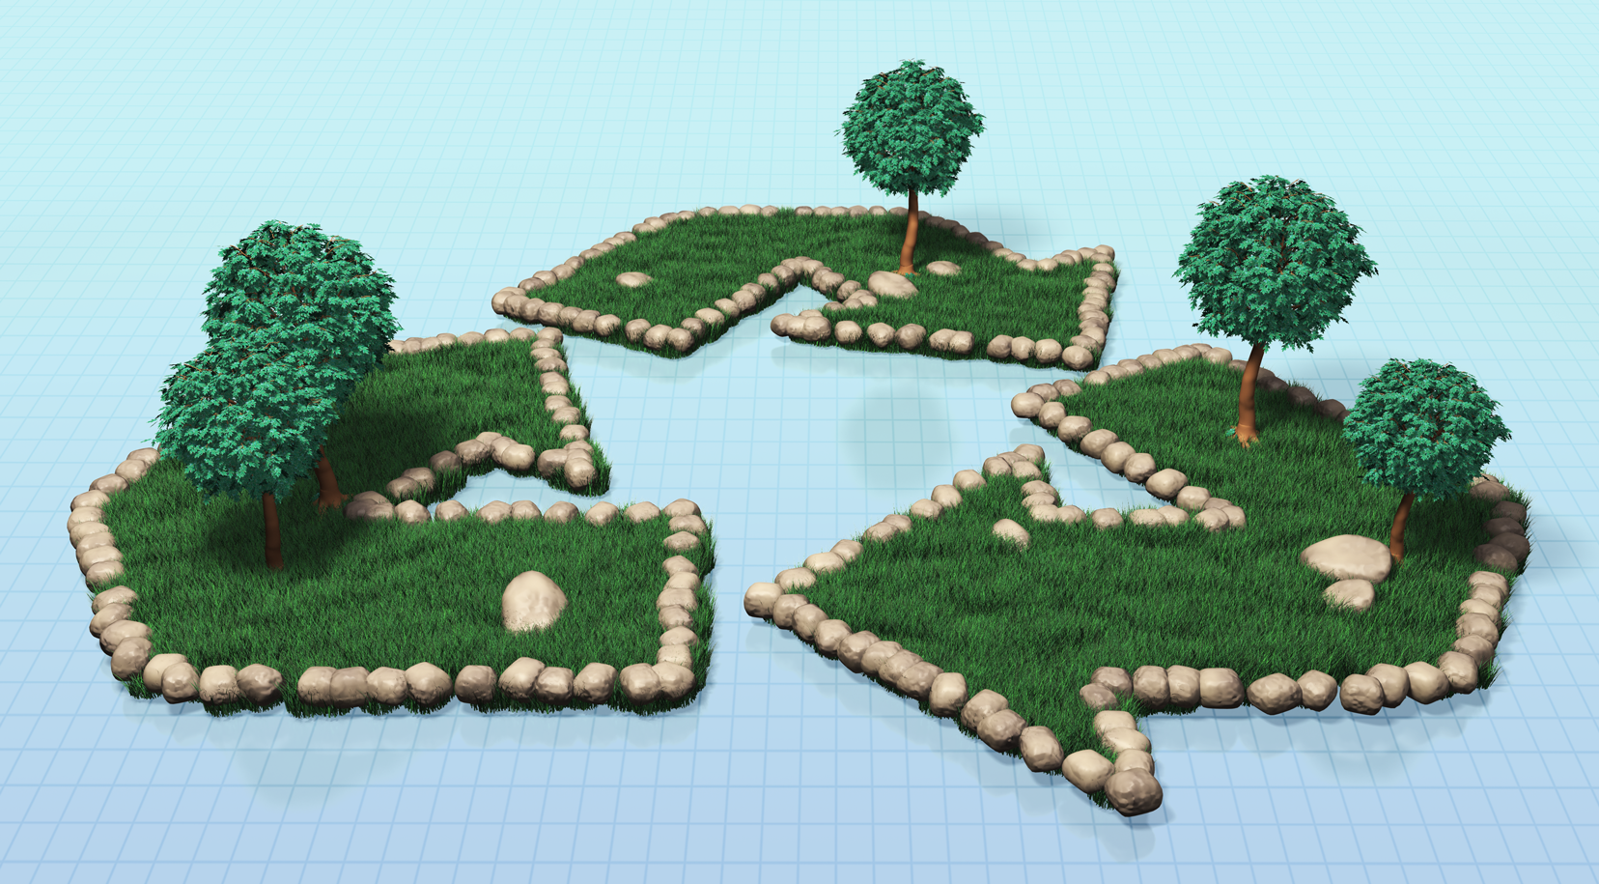

Questions???
Here is a place holder for the text. The earth flower on this page can be removed. Picture from PresenterMedia.com

Slide 11
A second line of text could go here
1
Discussion Item One Add a second line of text here
5
Discussion Item Five Add a second line of text here
2
Discussion Item Two Add a second line of text here
6
Discussion Item Six Add a second line of text here
3
Discussion Item Three Add a second line of text here
7
Discussion Item Seven Add a second line of text here
4
Discussion Item Four Add a second line of text here
8
Discussion Item Eight Add a second line of text here

Slide 12
Main Content Page Layout
Add a subtitle here
An accent box, click to edit the text inside.
This text is a placeholder.
Here is the second level.
You may change this text
Here is the third level
Formatting is controlled by the slide master and the layout pages.
There is a third level
And even a fourth level
An accent box, click to edit the text inside.

Slide 13
Comparison Page Layout
A callout, this can be edited or deleted
A second line of text could go here
Comparison of Item One
Comparison of Item Two
This is a place holder for item one. Item one can be text, a picture, graph, table, etc.
Here is level two
Here is level three
Level 4
This is a place holder for item one. Item one can be text, a picture, graph, table, etc.
Here is level two
Here is level three
Level 4, you may add more text or delete this text.

Slide 14

A Two Column Page Layout
A Second line of text can go here.
A content placeholder. Use for text, graphics, tables and graphs. You can change this text or delete it.
Here is a placeholder for more text. You may delete this text
Here is a placeholder for more text. You may delete this text

Slide 15

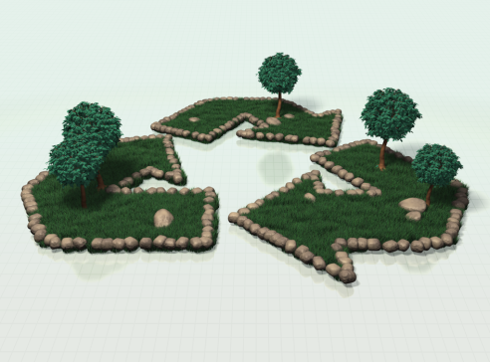
Two Picture Page Layout
A second line of text here
A placeholder for text for the first picture
More information can be added here by changing this text.
A placeholder for the second picture
More information can be added here by changing this text.
Make changes to this text.

Slide 16



Three Picture Page Layout
A second line of text may go here.
A description of the first picture. You may change this text.
A description of the second picture. You may change this text.
This is a text placeholder, you may change or delete this text.
A description of the third picture. You may change this text.
This is a text placeholder, you may change or delete this text.

Slide 17
Table Page Layout
A second line of text can go here.
Here is the description of the table. You may change or delete this text as you wish.
This chart is compatible with PowerPoint 97 to 2007.
Here is a placeholder for more text and description of the chart. Changing this text will not interfere with the formatting of this template.
Geographic Region | Q1 | Q2 | Q3 | Q4
United States | 1254 | 1254 | 1254 | 1254
Europe and Asia | 324 | 324 | 324 | 324
Australia | 32 | 32 | 32 | 32
South America | 2 | 2 | 2 | 2
Canada | 1 | 1 | 1 | 1
Mexico | 1 | 1 | 1 | 1
TOTALS | 1614 | 1614 | 1614 | 1614

Slide 18
Comparison Table Layout
A second line of text can go here.
Quarter | North America | Asia | Europe | Australia
Q1 2009 | 123 | 34 | 45 | 10
Q2 2009 | 134 | 35 | 44 | 12
Q3 2009 | 150 | 45 | 50 | 14
Q4 2009 | 201 | 55 | 60 | 18
Q1 2010 | 175 | 44 | 47 | 13
Q2 2010 | 180 | 48 | 52 | 14
Q3 2010 | 204 | 55 | 60 | 16
Q4 2010 | 250 | 62 | 70 | 20
Quarter | North America | Asia | Europe | Australia
Q1 2009 | 123 | 34 | 45 | 10
Q2 2009 | 134 | 35 | 44 | 12
Q3 2009 | 150 | 45 | 50 | 14
Q4 2009 | 201 | 55 | 60 | 18
Q1 2010 | 175 | 44 | 47 | 13
Q2 2010 | 180 | 48 | 52 | 14
Q3 2010 | 204 | 55 | 60 | 16
Q4 2010 | 250 | 62 | 70 | 20
Here is the description of the table. You may change or delete this text as you wish. This table is compatible with PowerPoint 97 to 2007.

Slide 19
Bar Graph Page Layout
A Second Line of text may go here
Here is the description of the chart. You may change or delete this text as you wish.
This chart is compatible with PowerPoint 97 to 2007.
Here is a placeholder for more text and description of the chart. Changing this text will not interfere with the formatting of this template.

Slide 20
Pie Graph Page Layout
PowerPoint 97 through 2007 Compatible
Here is the description of the chart. You may change or delete this text as you wish.
This chart is compatible with PowerPoint 97 to 2007.
Here is a placeholder for more text and description of the chart. Changing this text will not interfere with the formatting of this template.
Star Burst!

Slide 21
Pie Graph Page Layout
PowerPoint 97 through 2007 Compatible
Here is the description of the chart. You may change or delete this text as you wish.
This chart is compatible with PowerPoint 97 to 2007.
Here is a placeholder for more text and description of the chart. Changing this text will not interfere with the formatting of this template.
Star Burst!

Slide 22
Bar Graph Page Layout
PowerPoint 2007 Enhanced Version
Here is the description of the chart. You may change or delete this text as you wish.
This chart utilizes features only available with 2007.
Here is a placeholder for more text and description of the chart. Changing this text will not interfere with the formatting of this template.
A callout, this can be edited or deleted

Slide 23
Pie Graph Page Layout
PowerPoint 2007 Enhanced Version
Here is the description of the chart. You may change or delete this text as you wish.
This chart utilizes features only available with 2007.
Here is a placeholder for more text and description of the chart. Changing this text will not interfere with the formatting of this template.

Slide 24
Smart Art Page Layout
PowerPoint 2007 Enhanced Version
Stage 1
Stage 2
Stage 4
Stage 3
Stage 5
Stage 6
This chart utilizes Smart Art which is feature in PowerPoint 2007. If you wish to make charts like this and don’t have PPT 2007, we have provided the graphical elements to help you build this yourself.
Here is the description of the chart. You may change or delete this text as you wish.
Here is a placeholder for more text and description of the chart. Changing this text will not interfere with the formatting of this template.

Slide 25
Smart Art Page Layout
PowerPoint 2007 Enhanced Version
Person 1
Person 3
Person 4
Person 5
Person 6
Person 9
Person 11
Person 12
Person 13
Person 14
Person 2
Person7
Person 8
Person 10
This chart utilizes Smart Art which is feature in PowerPoint 2007. If you wish to make charts like this and don’t have PPT 2007, we have provided the graphical elements to help you build this yourself.
Here is the description of the chart. You may change or delete this text as you wish.
Here is a placeholder for more text and description of the chart. Changing this text will not interfere with the formatting of this template.

Slide 26
Smart Art Page Layout
PowerPoint 2007 Enhanced Version
Process 1 A placeholder for text for more information
Process 2 A placeholder for text for more information
Process 3 A placeholder for text for more information
Process 4 A placeholder for text for more information
Process 5 A placeholder for text for more information
This chart utilizes Smart Art which is feature in PowerPoint 2007. If you wish to make charts like this and don’t have PPT 2007, we have provided the graphical elements to help you build this yourself.
Here is the description of the chart. You may change or delete this text as you wish.

